Slide 1
Per capita CO2 emissions
About the co2 emissions in various countries around the globe
Last updated on
24 February 2022

Slide 2
Co2 emission per capita
Co2 emission per capita = Amount of co2 emitted by the country
Total population of the country

Slide 3
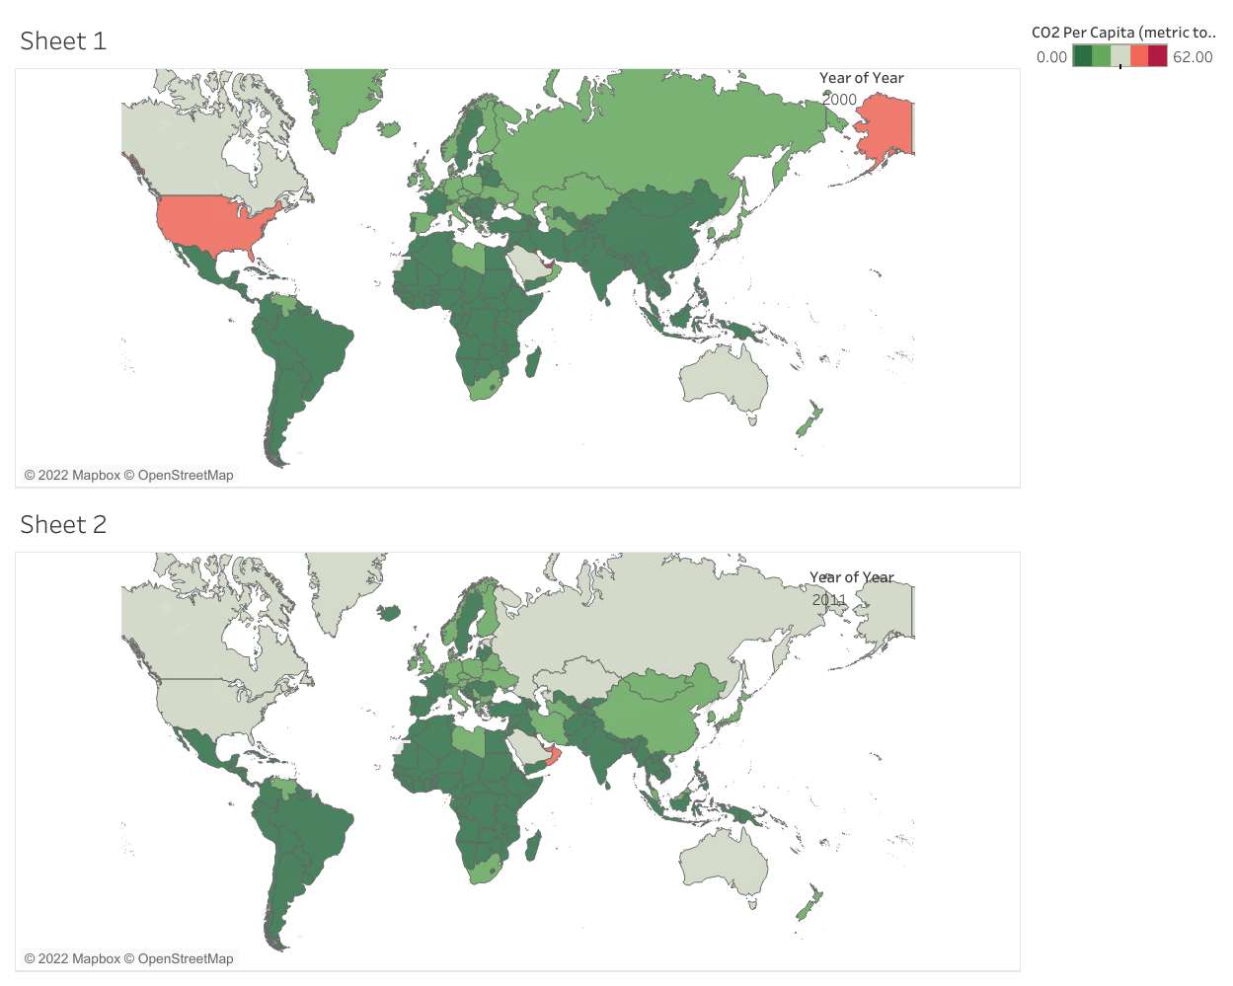
Co2 emissions around the world for year 2000 and 2011

Slide 4
The decrease in co2 emissions per capita is due to the increase in use of natural gas and a drop is US economic production during 2007-2009.

